Slide 1
ISPTO Financial Workshop
SEPTEMBER 30, 2026

Slide 2
Cincinnati, Ohio – Former Westwood PTO Treasurer Accused of Stealing Over $40K
Kathryn Burry has been charged with grand theft, a fourth-degree felony, for allegedly embezzling in excess of $25,000
August 2024 civil complaint filed by PTO claiming Burry stole more than $40,00 from the PTO. She was the PTO Treasurer since Aug 2021.
Burry provided minimal financial reports to the board despite repeated requests and had avoided multiple requests for financial information, raising concerns regarding the financial activities of the organization.
She engaged in a pattern of misrepresentations and presented the board with fraudulent statements.
PTO president contacted the bank and learned account balances were significantly lower than they were led to believe with unauthorized payments being made from PTO funds.
Sentenced to 90 days in the Geauga County Safety Center and had to pay restitution.

Slide 3
Fiduciary Duties and Responsibilities of Nonprofit Board Members
Duty of Care
  Prepare & attend meetings, establish policies, financial controls
Duty of Loyalty
  Interest of charity above personal interest, conflict of interest policy
Duty to Maintain Accounts
  Maintain accurate records, budgets, internal controls, record retention
Duty of Compliance
  Comply with federal & state law, governing documents, contracts, Attorney General, Secretary of State

Slide 4
Resources for YOU
District website – Treasurer’s Page
PTO and Booster Group Resources
Resources for new groups, Links for filings, Trainings and Resources, District-specific information, Relevant Board Policies
Notes:
Pull up webpage and show navigation

Slide 5
Policy KMA Highlights
Organization should have bylaws
Obtain 501c3 designation with the IRS
Abide by minimum good accounting and internal control practices
Notes:
Policy KMA applies to District Support Organizations

Slide 6
Policy KMA Highlights (cont.)
Staff members are encouraged to join but not be the Treasurer or handle booster group funds
Student participation on athletic teams or in co-curricular activities is completely independent of any fund-raising activities

Slide 7
Policy KMA Highlights (cont.)
If more than $1,000, monies should be deposited on the next business day after the day of receipt.
If less than $1,000, monies should be deposited no more than 3 business days after the day of receipt.

Slide 8
Policy KMA Annual Requirements
Copy of most recent IRS Form 990
Certificate indicating filing requirements with Ohio Attorney General have been met
List of Current Officers with Contact information
List of proposed fund-raising activities
Copy of most recent charter documents if changed

Slide 9
Policy KMA Annual Requirements
HCSD Board provides coverage under the District’s liability insurance program at no cost to the organization to protect the entity against legal claims resulting from damage or injury from any act or omission.
At a cost to the support organization, the District will purchase an insurance policy with crime coverage for officers of the organization to protect the funds in the event of a covered loss.
  Fee is based on total revenues per 990 tax filing
  Invoiced in February
Notes:
The highest Fees in recent years have been: $75/$100/$150
Premium amount divided between groups
Ohio School Plan

Slide 10
Policy KMA Annual Requirements
NEW REQUIREMENT added in 2024
Each District support organization shall require its president and treasurer to complete training requirements provided by the Ohio Attorney General Charitable University, and to maintain Charitable University certification with the Ohio Attorney General at all times while serving in the roles of president and treasurer. Completion of the training shall be required within 90 days start of term of office, unless the individual already holds an unexpired certification.

Slide 11
Ohio Attorney General – Charitable University
Beginning in January 2023, the Ohio AG debuted their Charitable University
Online training program designed to equip nonprofit leaders with basic tools needed to support the ongoing efforts of their organization
https://charitable.ohioago.gov/
Covers fiduciary responsibilities, workshops, webinars, publications, FAQs
Multiple modules, not all required for certification
Approximately 60-90 minutes to complete
Certification is good for 3 years from the date of completion

Slide 12
Internal Controls
Any event involving cash should have two people count the cash
Either deposit the cash immediately or safeguard the cash – deposit ASAP
All cash should be deposited – don’t pay bills with cash
Try to limit the number of people handling cash
No checks written to cash
Notes:
Deposits of more than $1000 should be deposited next business day following receipt
Deposits of less than $1000 deposited no more than 3 business days after receipt

Slide 13
Internal Controls
Dual signatures on checks or similar process
Bank account reconciled monthly
Financial reports provided monthly to members of the booster group
Credit/debit card procedures
Audit??
Notes:
debit cards discouraged because of ability to withdraw cash. In some cases, debit card may be the only card option.
No cash withdrawals!

Slide 14
Venmo – Why you should reconsider
Accounts are connected to one individual (phone number)
Does not provide tax receipts to donors
Charity profile cannot be edited on a computer, only through app
Other platforms are catered to the specific needs of PTOs
Look at controls, policies, procedures
Notes:
Venmo wants the Phone number connected to be a business number which needs to be an actual number, not the school or Google voice number. Leaves option to be volunteer’s number unless you pay for a business phone.
Charities are responsible for sending an official written acknowledgement or tax receipt to donors. You have to download this information from Venmo and send the receipts.
Cannot convert existing business profile to a charity profile.
Need a mobile number to create an account and cannot create a second account with a single number.
Consider: How easy does it make it for one person to have sole control over something connected directly to your bank account?
How does the account get handed off from year to year if connected to a personal phone number?

Slide 15
Contract review process
All contracts for rentals, including inflatables, etc. must be reviewed by the district business office
Our insurance company now requires this
This review process applies even if the PTO is paying for the event instead of the district.

Slide 16
Fundraising
Bingo – license required
Casino Night – run by volunteers on property owned by a non-profit, no craps or roulette
Raffles – only charitable organizations, not individuals
Silent Auctions – acceptable
Squares – not permitted, considered illegal pools for profit, all money must be distributed to winners
50/50 raffles - acceptable
Notes:
Refer to ORC for specific details
Bingo includes purse bingo
Raffling alcohol has specific requirements on receipts. Alcohol must be purchases in Ohio and liquor taxes paid.

Slide 17
Requirements – Secretary of State
Register with the Secretary of State
File articles of incorporation
Appoint Statutory Agent
Pay initial $99 fee
Recommend use of generic email that is passed on
Every 5 years thereafter file a “Statement of Continued Existence” (Form 522)
$25 filing fee
Notes:
To be legally organized, a non-profit must file Form 532B Initial Articles of Incorporation with Secretary of State
Will receive notification prior to needed continued existence filing; this is the reason for the generic email – so the officers don’t move on and deadline is missed.

Slide 18
Annual Requirements - IRS
Annually file Form 990
Less than $50,000 in revenue 990-N
Less than $200,000 in revenue 990-EZ
File by the 15th day of the 5th month following fiscal year end (i.e. November 15 for June 30 fiscal year end)
A 3 year failure to file equals automatic revocation of your tax exempt status

Slide 19
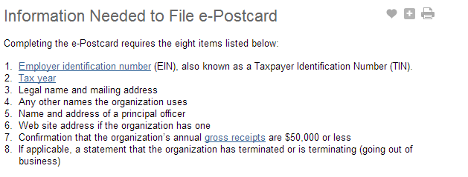
IRS 990-N

Slide 20
Annual Requirements – Ohio Attorney General
All charitable organizations must register with the Ohio AG.
Ohio requires charitable organizations located in Ohio and groups that ask Ohioans for contributions to file annual reports with the AG’s office.
Online system to create accounts for organization members
Notes:
Generic email for registration is helpful for receiving reminders

Slide 21
Ohio Attorney General – Cybersecurity Issues
Fraudulent emails and text messages
Beware of phishing schemes
Investigate who emails are coming from
Verify with sender using non-email method
Stop email from going further – report/delete
Router and Wi-fi security on your device
Notes:
Phishing schemes – attempt to get you to give up credentials or click on a link to install malware.

Slide 22
Records Retention
Checklist created for ease
Signed by outgoing and incoming PTO treasurer and president
Ensure records are collected an passed on as board members change
Ensure proper retention of documents
Demonstrate compliance with tax rules and qualification for tax-exempt status
Keep records supporting an item on federal returns until the statute of limitations for that return runs out

Slide 23
Records Retention – Permanent Records
Application for recognition of tax-exempt status
IRS determination letter
Organizing documents, i.e. Articles of Incorporation, by-laws, including amendments
Board minutes

Slide 24
Ethics - Compensation
Ohio Ethics Advisory Opinion 2008-01
School district employees and Board-approved school volunteers MAY NOT BE COMPENSATED by District Support Organization
No compensation or supplemental compensation permitted
Gift cards are considered compensation
Notes:
Consider providing items for the classroom in lieu of personal gifts if PTO is collecting for group holiday, appreciation gifts

Slide 25
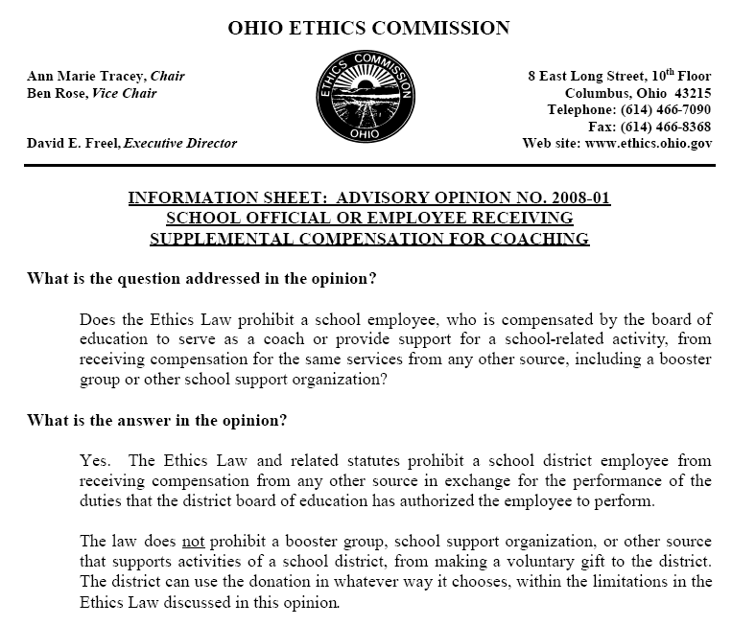

Slide 26
Other Issues?

